Slide 1
Deep Learning Training
Lecture 7: Gated Recurrent Units, Attention

Slide 2
Content
Vanishing and Exploding Gradients
GRU
LSTM
Deep Recurrent Neural Network
Bidirectional RNN
Attention

Slide 3
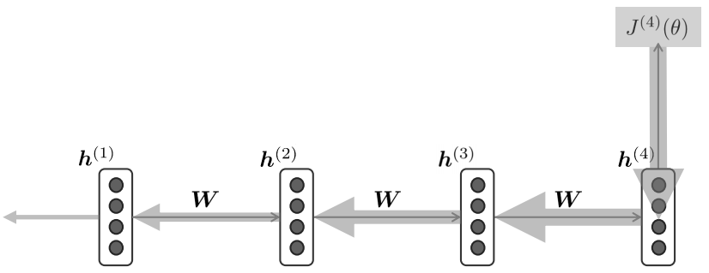
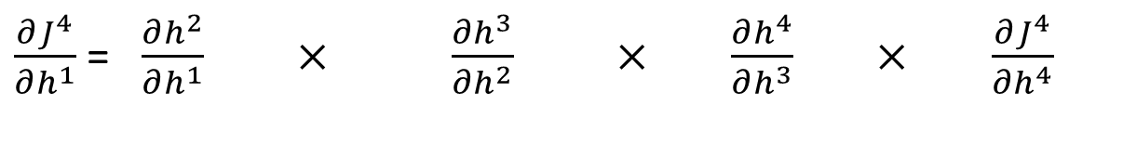
RNN and Vanishing Gradients
Caused by repeated multiplication of weight matrix during back propagation
Prevents RNN from learning long term dependency
Training becomes very slow
$\frac{∂J^{4}}{∂h^{1}}$ = $\frac{∂h^{2}}{∂h^{1}} × \frac{∂h^{3}}{∂h^{2}} ×$ $\frac{∂h^{4}}{∂h^{3}} ×$ $\frac{∂J^{4}}{∂h^{4}}$

Slide 4
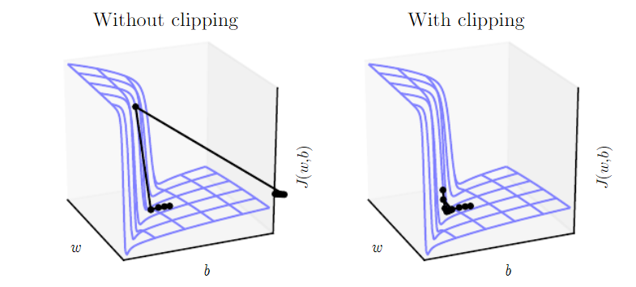
Exploding Gradients
We take too large a step and end up with a configuration with more loss
Can be lessened by clipping gradient values or penalty
Figure: Example of the eﬀect of gradient clipping in RNN with two parameters w and b

Slide 5
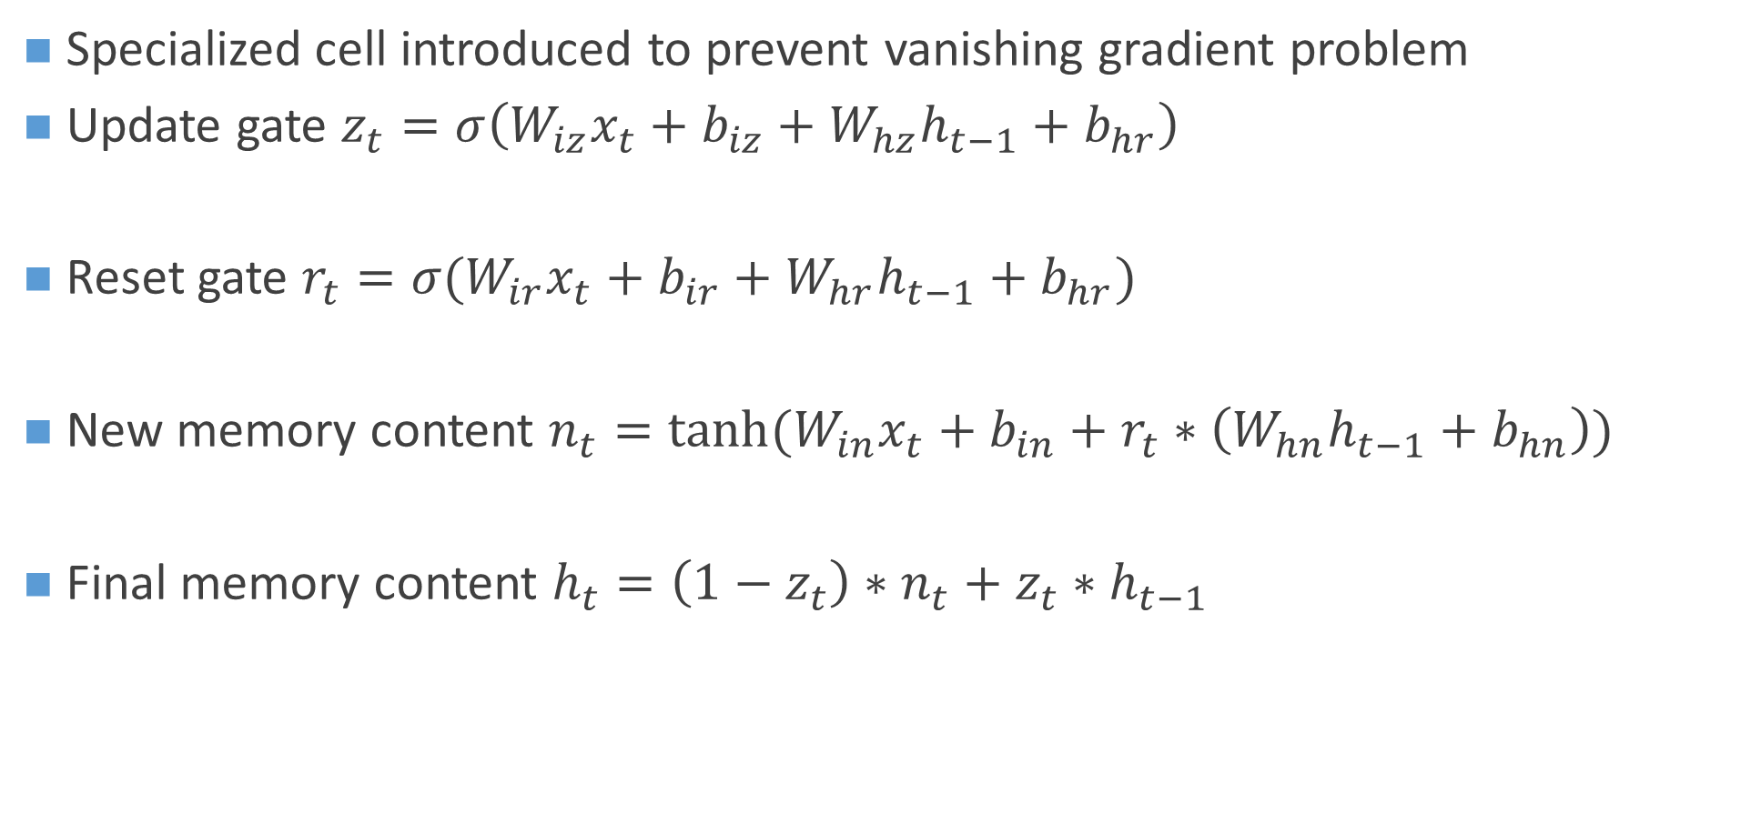
Gated Recurrent Unit (GRU)
Specialized cell introduced to prevent vanishing gradient problem
Update gate $z_{t}=σ\left(W_{iz}x_{t}+b_{iz}+W_{hz}h_{t−1}+b_{hr}\right)$
Reset gate $r_{t}=σ(W_{ir}x_{t}+b_{ir}+W_{hr}h_{t−1}+b_{hr})$
New memory content $n_{t}=tanh⁡(W_{in}x_{t}+b_{in}+r_{t}∗\left(W_{hn}h_{t−1}+b_{hn}\right))$
Final memory content $h_{t}=\left(1−z_{t}\right)∗n_{t}+z_{t}∗h_{t−1}$

Slide 6
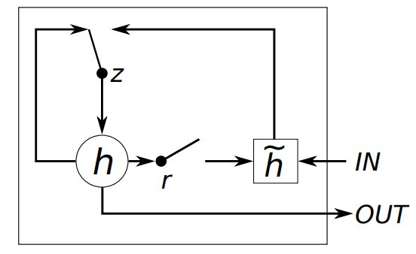
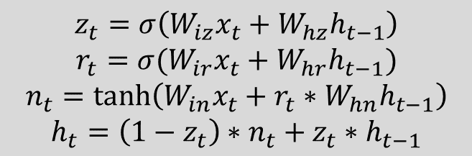
Gated Recurrent Unit (GRU)
$$z_{t}=σ\left(W_{iz}x_{t}+W_{hz}h_{t−1}\right)$$
$$r_{t}=σ(W_{ir}x_{t}+W_{hr}h_{t−1})$$
$$n_{t}=\tanh\left(W_{in}x_{t}+r_{t}∗W_{hn}h_{t−1}\right)$$
$$h_{t}=\left(1−z_{t}\right)∗n_{t}+z_{t}∗h_{t−1}$$
Figure: Gated recurrent unit

Slide 7

Gated Recurrent Unit (GRU)
If reset is close to 0, ignore previous hidden state
Allows model to drop information that is
irrelevant in the future
Units with short term dependencies have
update gate more active
Update gate controls how much of past state should matter now
If update gate close to 1 we can copy information in that unit through many time steps
Works as skip connection and prevents vanishing gradients
Prunes unnecessary connection using reset gate, adds shortcut connection using update gate
$$z_{t}=σ\left(W_{iz}x_{t}+W_{hz}h_{t−1}\right)$$
$$r_{t}=σ(W_{ir}x_{t}+W_{hr}h_{t−1})$$
$$n_{t}=\tanh\left(W_{in}x_{t}+r_{t}∗W_{hn}h_{t−1}\right)$$
$$h_{t}=\left(1−z_{t}\right)∗n_{t}+z_{t}∗h_{t−1}$$

Slide 8
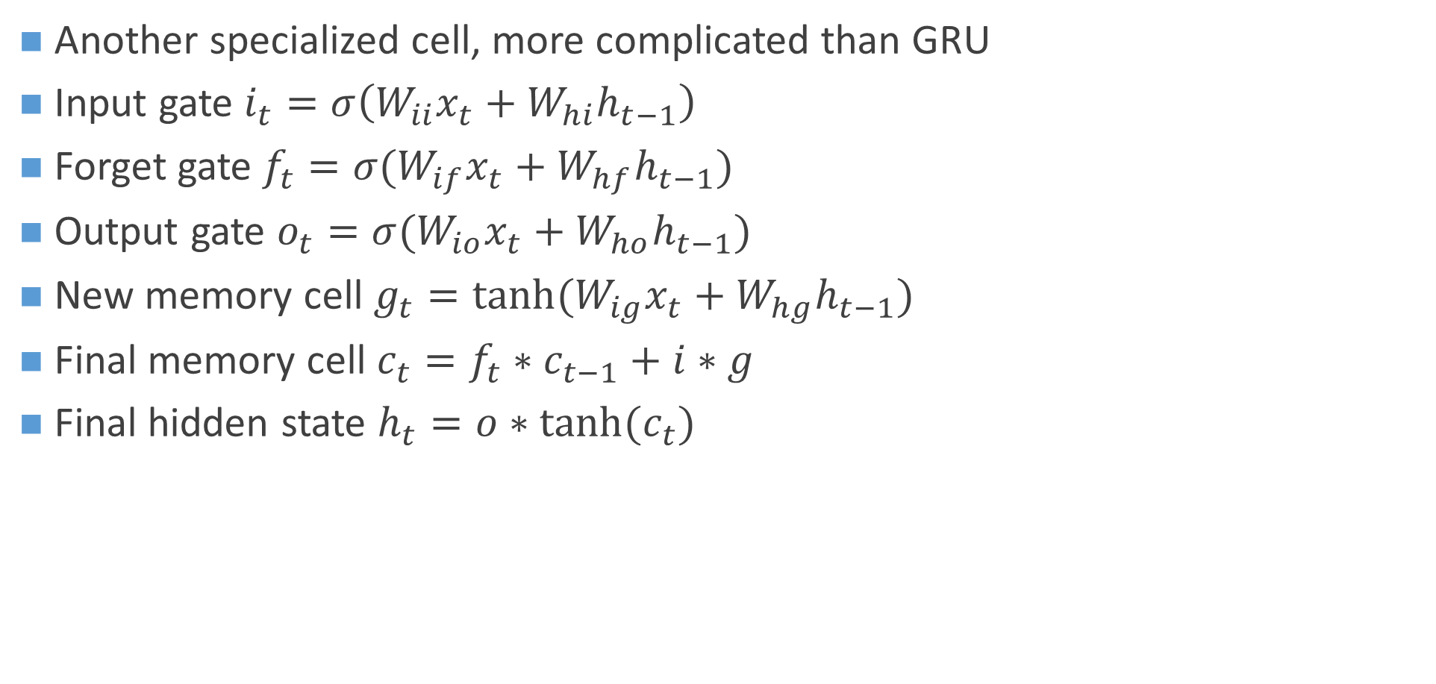
Long Short Term Memory (LSTM)
Another specialized cell, more complicated than GRU
Input gate $i_{t}=σ\left(W_{ii}x_{t}+W_{hi}h_{t−1}\right)$
Forget gate $f_{t}=σ(W_{if}x_{t}+W_{hf}h_{t−1})$
Output gate $o_{t}=σ(W_{io}x_{t}+W_{ho}h_{t−1})$
New memory cell $g_{t}=tanh⁡(W_{ig}x_{t}+W_{hg}h_{t−1})$
Final memory cell $c_{t}=f_{t}∗c_{t−1}+i∗g$
Final hidden state $h_{t}=o∗tanh⁡(c_{t})$

Slide 9
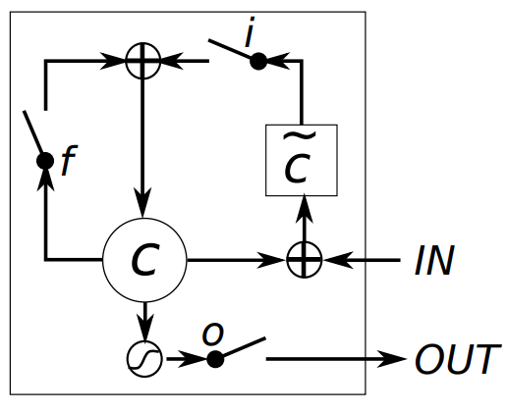
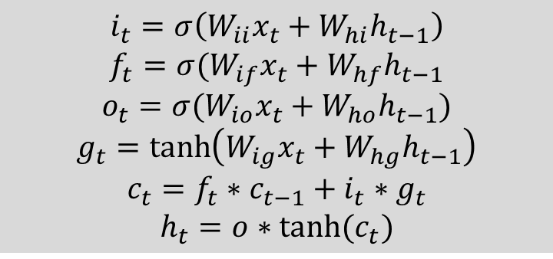
LSTM
$$i_{t}=σ\left(W_{ii}x_{t}+W_{hi}h_{t−1}\right)$$
$$f_{t}=σ(W_{if}x_{t}+W_{hf}h_{t−1}$$
$$o_{t}=σ(W_{io}x_{t}+W_{ho}h_{t−1})$$
$$g_{t}=\tanh\left(W_{ig}x_{t}+W_{hg}h_{t−1}\right)$$
$$c_{t}=f_{t}∗c_{t−1}+i_{t}∗g_{t}$$
$$h_{t}=o∗tanh⁡(c_{t})$$
Figure: Long short term memory

Slide 10

LSTM
Input gate controls what part of input is written into new cell
Forget gate controls what portion of previous cell content is forgotten
Output gate controls what part of cell content are exposed to hidden state
If forget gate is set to remember (close to 1) it can preserve information for long time
$$i_{t}=σ\left(W_{ii}x_{t}+W_{hi}h_{t−1}\right)$$
$$f_{t}=σ(W_{if}x_{t}+W_{hf}h_{t−1}$$
$$o_{t}=σ(W_{io}x_{t}+W_{ho}h_{t−1})$$
$$g_{t}=\tanh\left(W_{ig}x_{t}+W_{hg}h_{t−1}\right)$$
$$c_{t}=f_{t}∗c_{t−1}+i_{t}∗g_{t}$$
$$h_{t}=o∗tanh⁡(c_{t})$$

Slide 11
LSTM
LSTM makes it possible to learn very long term dependencies
Unlike vanilla RNN it can learn dependencies in order of hundreds sequence length
Applied in many state of the art sequence models
Computationally expensive
Doesn’t guarantee preventing vanishing gradients but provides easier flow via skip connection

Slide 12
LSTM vs GRU
Many other variants have been developed
GRU is computationally cheaper
LSTM usually provides better performance but not always
Good choice is to start with LSTM and switch to GRU if efficiency required

Slide 13
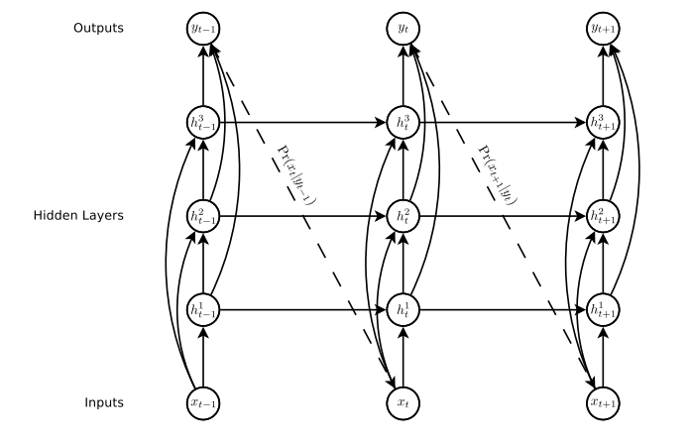
Deep Recurrent Neural Net
Consists of stacked hidden units
Allows to learn hierarchical representation
Computationally expensive

Slide 14
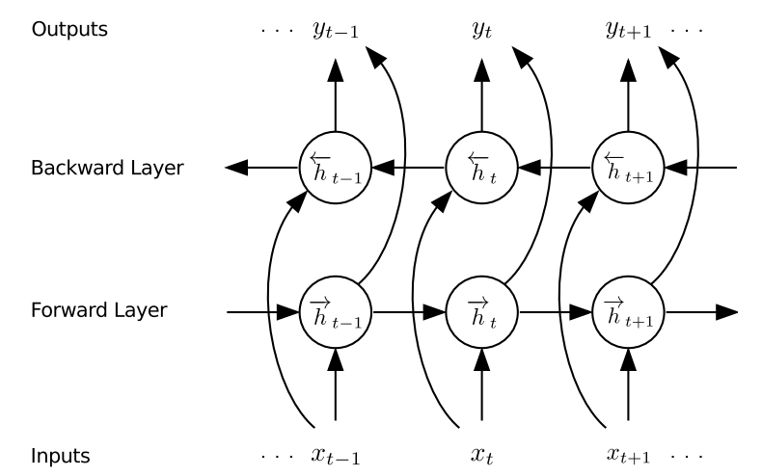
Bidirectional RNN
Takes information from past and future into account
Provides better context
Superior performance in speech recognition, machine translation task

Slide 15
Attention
Allows network direct connection to focus on particular part of previous sequence
Can learn to align non-sequentially in sequence to sequence model
Better performance in translation task
Helps with vanishing gradient
Prevents encoder bottleneck problem
Provides interpretability

Slide 16
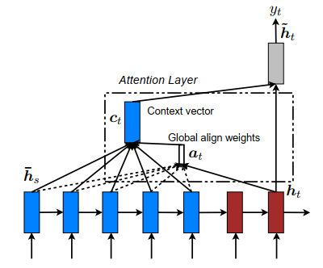
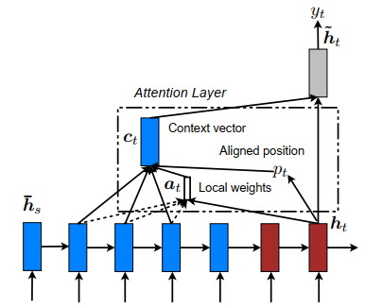
Global and Local Attention
Figure: Global(left) and local(right) attention model source

Slide 17
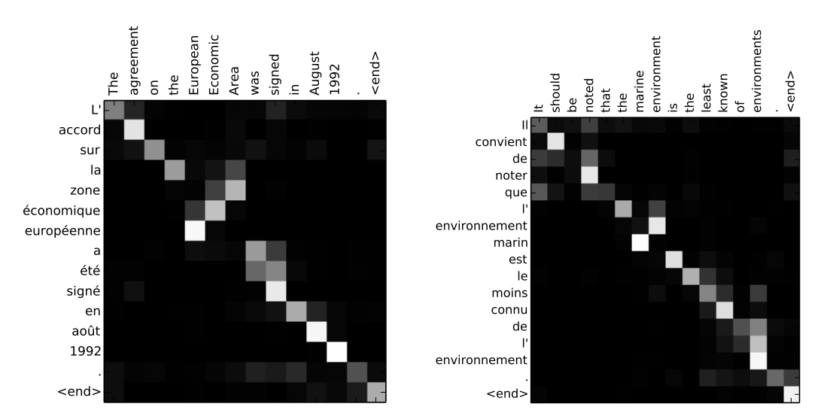
Attention: Alignment
Figure: Alignments between source (English, top) and target(French, right) translation source

Slide 18
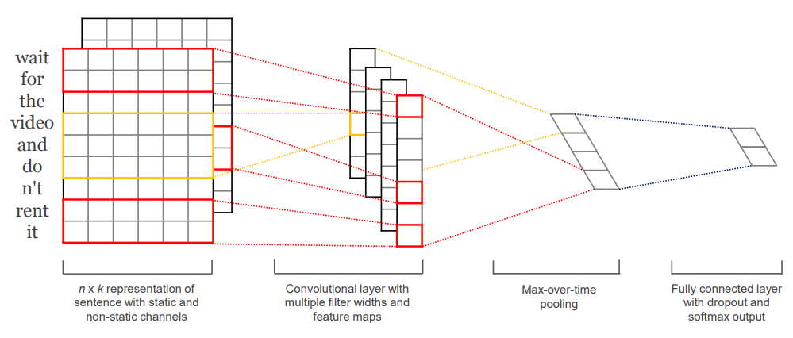
Convolutional Neural Network for Sentence Classification
Use convolutional feed forward neural network
Performance comparable to RNN based structure for classification
Simpler and computationally cheaper
Figure: CNN model architecture for sentence classification source

Slide 19
Thank You

Slide 20
Reference
https://www.deeplearningbook.org/contents/rnn.html
https://towardsdatascience.com/illustrated-guide-to-lstms-and-gru-s-a-step-by-step-explanation-44e9eb85bf21
http://d2l.ai/chapter_recurrent-neural-networks/index.html
http://colah.github.io/posts/2015-08-Understanding-LSTMs/
https://web.stanford.edu/class/archive/cs/cs224n/cs224n.1174/lectures/vanishing_grad_example.html
https://web.stanford.edu/class/archive/cs/cs224n/cs224n.1184/syllabus.html
Empirical Evaluation of Gated Recurrent Neural Networks on Sequence Modeling
Generating Sequences With Recurrent Neural Networks
https://aclweb.org/anthology/D15-1166
https://skymind.ai/wiki/attention-mechanism-memory-network
https://arxiv.org/abs/1409.0473
https://www.aclweb.org/anthology/D14-1181

